Slide 1

www.tweakteach.com
©2025 TweakTeach

Slide 2

To study the rise and fall of the Songhay Empire
Why was the Songhay empire for trade and Islam?
The Songhay Empire

Slide 3

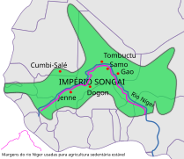
Location and Features
  The Songhay empire is known as one of the largest West African empires.
  The empire expanded in the 15ᵗʰ and 16ᵗʰ centuries
  The empire was situated near the Niger River – this region today is called Mali
  The second most important city of Songhay was Timbuktu, after Gao
  The main religion was Islam
Wikimedia: Songhay Empire
Notes:
https://commons.wikimedia.org/w/index.php?search=songhay+empire&title=Special:MediaSearch&type=image&haslicense=unrestricted
2

Slide 4

True or False
The main religion of Songhay was Islam.

