Slide 1
Kingdom of Benin c. 1500 –c.1750
To what extent was the trade in enslaved people the cause for the rise and fall of Benin?

Slide 2
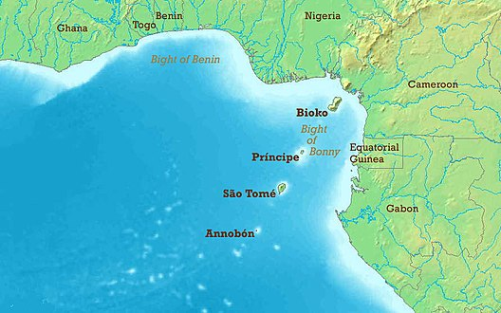
Location and Features
Benin was a Western African Kingdom and became a part of Nigeria.
The word Oba is associated with the King.
The oral literature provides us with a story related to the first Oba of Benin.
The heart of the empire was its capital at Edo
This Photo by Unknown Author is licensed under CC BY-SA
Circle the location of Benin on the map.

Slide 3
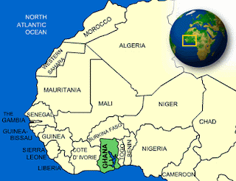
Edo were people who lived in Southern Nigeria
According to Edo Oral literature, the people were dissatisfied with the rulers and sent a request to another sacred town, Yoruba, to send a ruler. The divine ruler Ooni sent his son Oranmiyan, and his son Eweka became the First Oba of Benin.
This Photo by Unknown Author is licensed under CC BY-SA-NC

Slide 4
Benin in the 15th Century
Benin came under the rule of Oba Ewuare who was known to be a magician and a warrior.
People respected him, and he, in turn, gave power to town chiefs and palace chiefs.
Ewuare improved road structures which was also due to growing military strength.
Fill in the information table

